Slide 1
Complete new Cover page and content page
This will continue through to next term
Topic: Circles and Index Laws
Semester 2
Complete your learning log on measurement

Slide 2

Topic: Circles EQ: How do I find the circumference and area of a circle?
circles

Slide 3
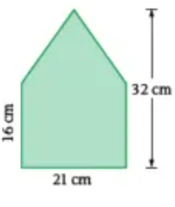

Have a go at these questions:
Topic: Circles EQ: How do I find the circumference and area of a circle?
Complete your summary from last lesson and update your contents page.
$3x−2y−6x+3=$
What is the formula to find the volume of a triangular prism?
Simplify $\frac{15}{20}$
What is the area of this shape? Show your working out.

Slide 4
Topic: Circles EQ: How do I find the circumference and area of a circle?
New Glossary words:
Circumference: Circumference is the distance around a circle.
Diameter: a line going from the circumference passing through the center of the circle.
Radius: half of the diameter, or a line from the center of the circle to the circumference.

Slide 5


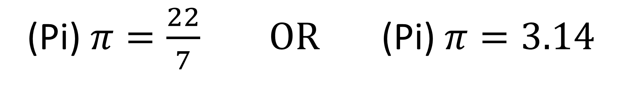
Topic: Circles EQ: How do I find the circumference and area of a circle?
(Pi) $π=\frac{22}{7} OR$(Pi) $π=3.14$

Slide 6

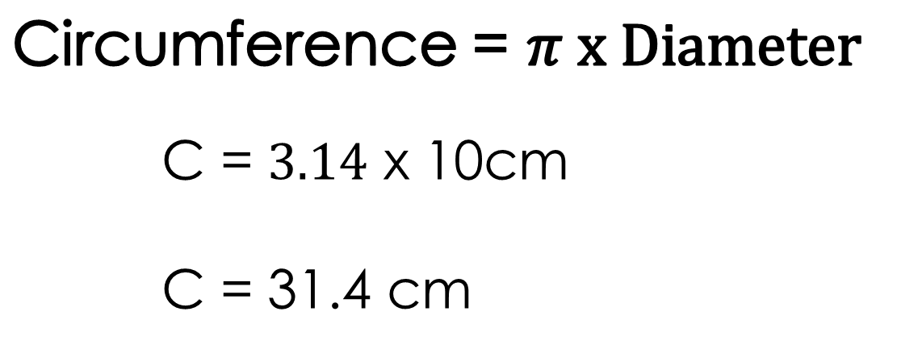
Topic: Circles EQ: How do I find the circumference and area of a circle?
Example 1: Find the circumference of the circle given.
Circumference = $π x Diameter$
C = $3.14$ x 10cm
C = 31.4 cm
10 cm
Since we were given the Diameter, we use the formula - Circumference = $π x Diameter$

Slide 7
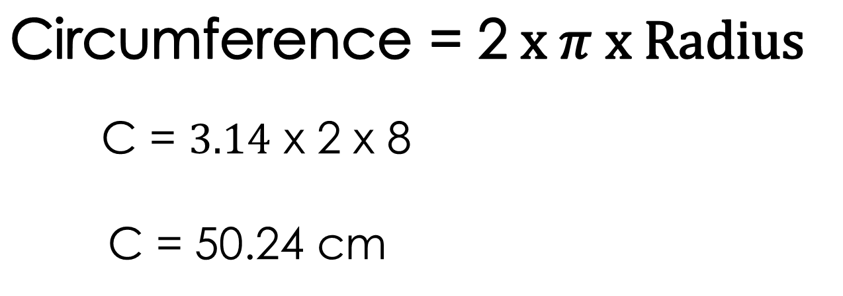
Topic: Circles EQ: How do I find the circumference and area of a circle?
Example 2: Find the circumference of the circle given.
Circumference = 2$x π x Radius$
C = $3.14$ x 2 x 8
C = 50.24 cm
8 cm
Since we were given the Radius, we use the formula - Circumference = 2$x π x Radius$

Slide 8
Try these on your own!
Calculate the circumference of each circle.
0.9 cm
1.6 cm
0.6 m
0.1 m
0.6 cm
0.8 m

Slide 9
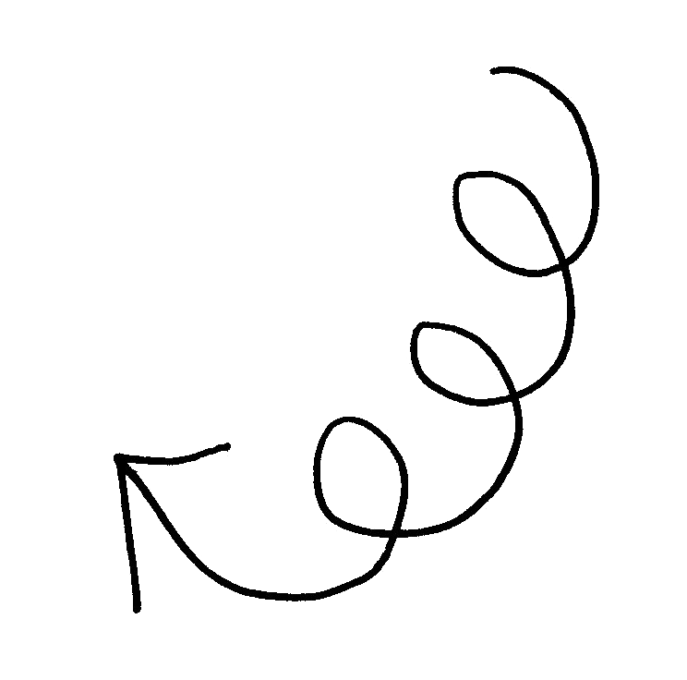

Topic: Circles EQ: How do I find the circumference and area of a circle?
Area refers to the space inside a shape or figure.
So how do we calculate Area?
As we can see, the circle has 1 radius (half of the diameter, or a line from the center of the circle to the circumference).
To calculate the Area of the Circle given, we use the formula
Area $=π x r^{2}$

Slide 10

Topic: Circles EQ: How do I find the circumference and area of a circle?
Example 1: Find the Area of the circle given.
$$A=πr^{2}$$
A = 3.14 x 4²
A = 3.14 x 16
A = 50.24cm
4cm

Slide 11
Calculate the area of each circle.
14 cm
18 m
Give these
a try!
8 m
10 m
4 m
10 in

Slide 12
What Questions
do you have??

